Slide 1


ACS 311A Group 6 Programming Language : RUST

Slide 2

Project Title
Personal Finance Planner

Slide 3
Member Roles
Geoffrey Ocholla (21-2066 ): Defining and creating the data structures in the project
Christopher Osiemo (21-2082) : Input and output considerations
Chadwick Madede (21-2111): Design specifications, research and working on front end design (GUI)
Patience Ndiritu (21-2077): DFD, documenting and creating database of client input

Slide 4

Problem Statement
Students today are young adults coupled with the responsibility to fend for themselves away from their parents, thus they have to manage their finances. Finances vary from one student to another depending on financial background, needs and responsibilities; however basic needs are still to be met no matter the budget. The need to meet basic needs, combined with motivation to beat peer pressure is a reason to create a budget planner to grow a saving culture among university students.

Slide 5
Background Study
Students have to learn how to manage their expenses on their own. Some from their guardians, elder relatives, financial aid and some international students also get aid from their countries
The harsh economic times are making it harder for students to use their money. The same money to cover many needs that have increased in prices. The challenges also of those who fend for themselves through business to survive as young independent adults.
The growing vices among youth that ‘eat’ their money such as drug abuse, chasing after women and parties, gambling etc are crippling the financial discipline of many campus students.

Slide 6
Functions of our Application
Allows users to create accounts
Users are saved together with their credentials in database
They input their income
They choose a budget plan, weekly and monthly
They give us how much they spent on each need to be met
We give feedback whether they met their budget or not and by how much
Users can change to another business plan, if income increases or decreases

Slide 7
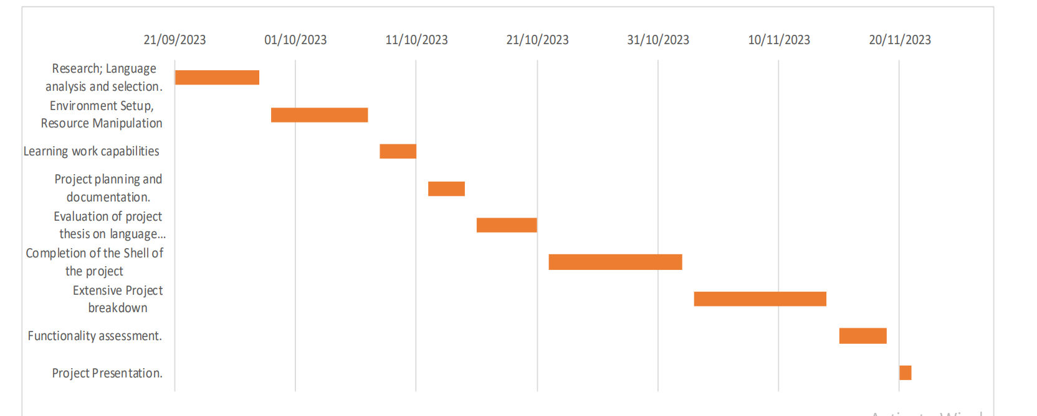
Implementation Timeline

Slide 8
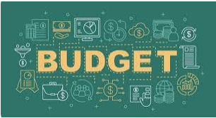
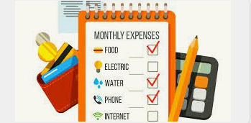
Project Features and Functionalities
Income input
Budget Plans
Tracking expenditure
Feedback if plan was met or not
A database of users and records of their expenditure

Slide 9
How our Application Works
Creating a database with users that allows new users with suitable credentials.
Creating a sign in/up module that takes in new users and secures passwords.
Allows user to give in their income
Suggests budget plans that MIGHT fit the user and allows them to use
Visually display how the budget will work with their income
Allows user to say “yes” or “no” They can work with it or choose another plan
User can update their expenditure daily, weekly and monthly
At the end of the week and month, the app tells user if the met budget or not. And by how much extra they have or they are less by how much.
Feedback is given to user at the end of the month is they met budget or not
Creating option for user to opt out of a budget plan in case new expenses come in or their income increases.

Slide 10


Deliverables of the Application
Suggests a budget plan that fits user’s income
Data analysis of one’s expenditure
Saves user data for further predictions
Improve saving skills of users

Slide 11

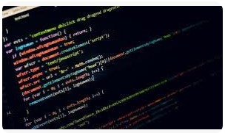
Limitations of our Project
Most of what makes Rust relatively hard is that the compiler is less forgiving of errors than other programming languages
Linking our database and application may require integration of another programming language because RUST doesn’t have such features.
Less community of RUST compared to other programming languages.

